Slide 1
Software Engineering (SE)
Lecture 30
Estimation for Software Project
By Sandia Kumari

Slide 2

Software Project Management
Software project management begins with a set of activities that are collectively called project planning. Before the project can begin, the software team should estimate the work to be done, the resources that will be required, and the time that will elapse from start to finish.

Slide 3
Once these activities are accomplished, the software team should establish a project schedule that defines software engineering tasks and milestones, identifies who is responsible for conducting each task, and specifies the intertask dependencies that may have a strong bearing on progress.
Planning requires you to make an initial commitment, even though it’s likely that this “commitment” will be proven wrong. Whenever estimates are made, you look into the future and accept some degree of uncertainty as a matter of course.
Although estimating is as much art as it is science

Slide 4
Software Estimation
Estimation of the size of software is an essential part of Software Project Management. It helps the project manager to further predict the effort and time which will be needed to build the project. Various measures are used in project size estimation. Some of these are:
Lines of Code
Number of entities in ER diagram
Total number of processes in detailed data flow diagram
Function points

Slide 5
Estimation
Estimation of resources, cost, and schedule for a software engineering effort requires
experience
access to good historical information (metrics)
the courage to commit to quantitative predictions when qualitative information is all that exists
Estimation carries inherent risk and this risk leads to uncertainty
Notes:
Metrics= characteristics that are countable including measuring software performance, planning work items, measuring productivity, and many other uses.

Slide 6


Slide 7
Function-Based Metrics
The function point (FP) metric can be used effectively as a means for measuring the functionality delivered by a system. Using historical data, the FP metric can then be used to
(1) estimate the cost or effort required to design, code, and test the software;
(2) predict the number of errors that will be encountered during testing; and
(3) forecast the number of components and/or the number of projected source lines in the implemented system.

Slide 8
Function points are derived using an empirical relationship based on countable (direct) measures of software’s information domain and qualitative assessments of software complexity. Information domain values are defined in the following manner:
External Inputs (EIS)
External Outputs (EOs)
External Inquiries (EQs)
Internal Logical Files (ILFs)
External Interface Files (EIFs)

Slide 9
Each external input originates from a user or is transmitted from another application and provides distinct application-oriented data or control information. Inputs are often used to update internal logical files (ILFs). (E.g. Writes, deletes, updates)
Each external output is derived data within the application that provides information to the user. In this context external output refers to reports, screens, error messages, etc. It is created by the application, hence derived.
An external inquiry is defined as an online input that results in the generation of some immediate software response in the form of an online output.

Slide 10
Each internal logical file is a logical grouping of data that resides within the application’s boundary and is maintained via external inputs.
is internally maintained,
it has some logical structure and
it is stored in a file.
Each external interface file is a logical grouping of data that resides external to the application but provides information that may be of use to the application.

Slide 11
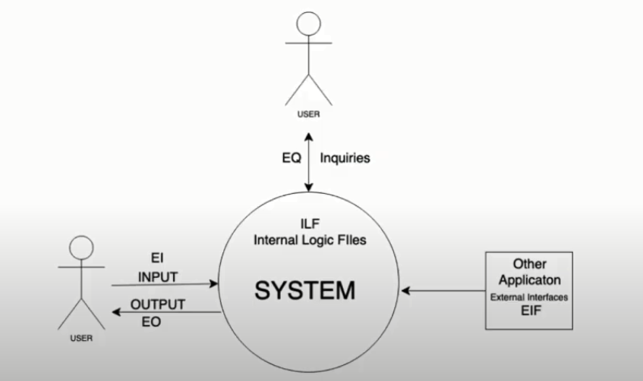
Information domain of system

Slide 12
Once these data have been collected, the table in Figure 1 is completed and a complexity value is associated with each count. Organizations that use function point methods develop criteria for determining whether a particular entry is simple, average, or complex. Nonetheless, the determination of complexity is somewhat subjective.
To compute function points (FP), the following relationship is used:
FP= count total x[0.65+0.01 x (Fi)] ----------------Equation 1
where count total is the sum of all FP entries obtained from Figure 1

Slide 13
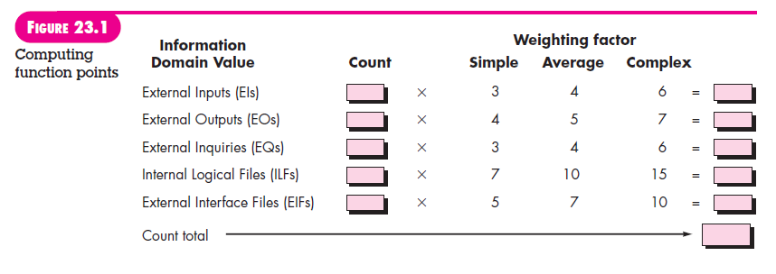
Figure 1

Slide 14
The Fi (i 1 to 14) are value adjustment factors (VAF) based on responses to the following questions
1. Does the system require reliable backup and recovery?
2. Are specialized data communications required to transfer information to or from the application?
3. Are there distributed processing functions?
4. Is performance critical?
5. Will the system run in an existing, heavily utilized operational environment?
6. Does the system require online data entry?
7. Does the online data entry require the input transaction to be built over multiple screens or operations?

Slide 15
8. Are the ILFs updated online?
9. Are the inputs, outputs, files, or inquiries complex?
10. Is the internal processing complex?
11. Is the code designed to be reusable?
12. Are conversion and installation included in the design?
13. Is the system designed for multiple installations in different organizations?
14. Is the application designed to facilitate change and ease of use by the user?

Slide 16
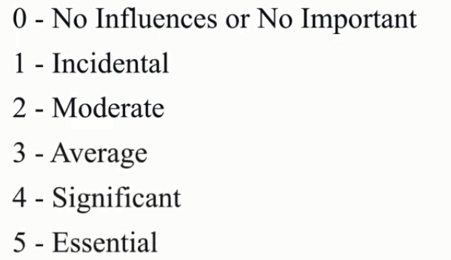
Each of these questions is answered using a scale that ranges from 0 (not important or applicable) to 5 (absolutely essential). The constant values in Equation (1) and the weighting factors that are applied to information domain counts are determined empirically.

Slide 17
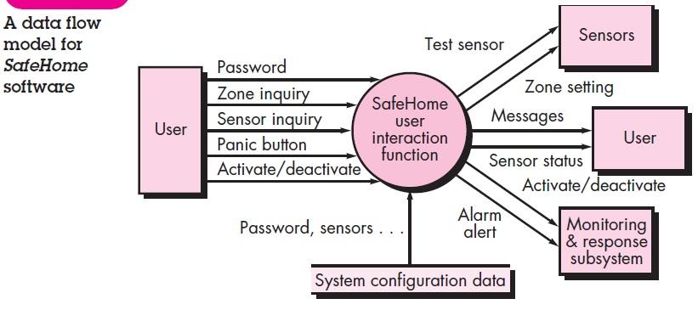
Figure 2
To illustrate the use of the FP metric in this context. Referring to the figure below, a data flow diagram for a function within the SafeHome software is represented.

Slide 18
The data flow diagram is evaluated to determine a set of key information domain measures required for computation of the function point metric.
Three external inputs—password, panic button, and activate/deactivate.
Two external inquiries—zone inquiry and sensor inquiry.
One ILF (system configuration file)
Two external outputs (messages and sensor status)
Four EIFs (test sensor, zone setting, activate/deactivate, and alarm alert)

Slide 19
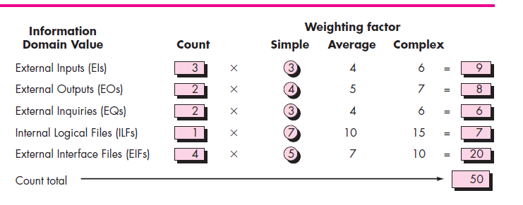

Slide 20
The count total shown in Figure 23.3 must be adjusted using Equation (1). For the purposes of this example, we assume that (Fi) is 46 (a moderately complex product). Therefore,
FP=50 x[0.65 +(0.01 x 46)] = 56

Slide 21
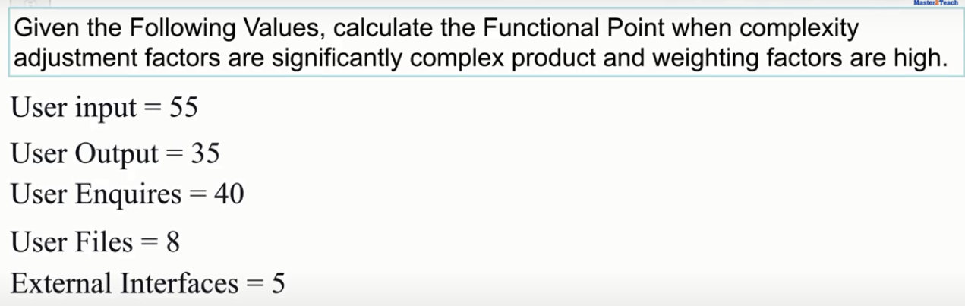
Problem

Slide 22
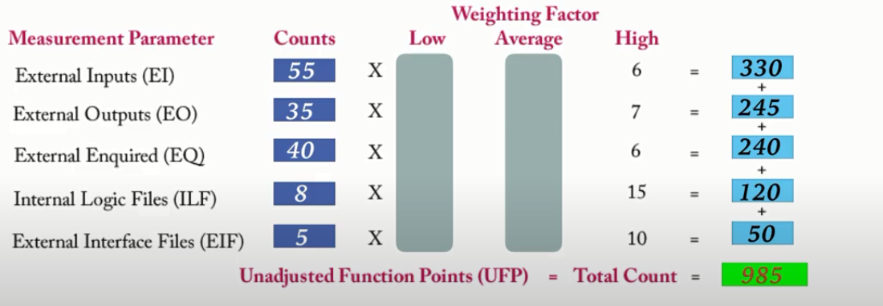
Solution

Slide 23
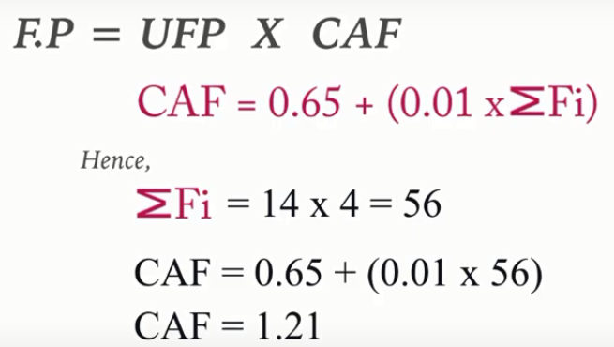
FP= count total x[0.65+0.01 x (Fi)] ----------------Equation 1
UFA= Unadjusted Functional point/ Total count
CFA = Complexity Factor Adjustment
Notes:
UFA= U

Slide 24
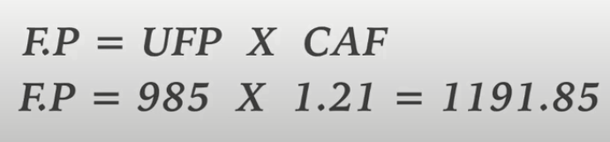
Final Answer

Slide 25
Thank you for listening

Slide 26
Software Engineering (SE)
Lecture 31
Estimation for Software Project
Estimation of LOC and Function Points using Historical Data
By Sandia Kumari

Slide 27
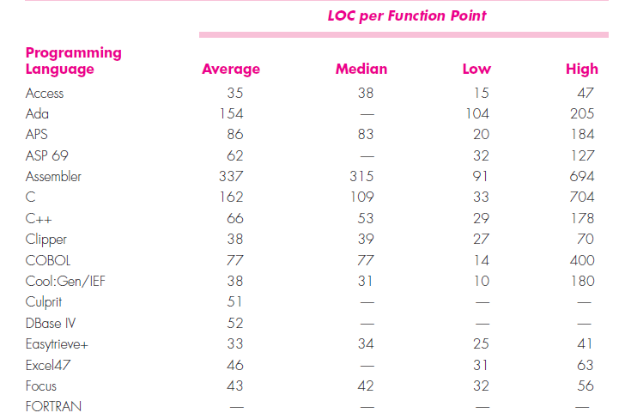
LOC based Estimation

Slide 28
LOC and FP data are used in two ways during software project estimation
(1) as estimation variables to “size” each element of the software and
(2) as baseline metrics collected from past projects and used in conjunction with estimation variables to develop cost and effort projections.

Slide 29
Regardless of the estimation variable that is used, you should begin by estimating a range of values for each function or information domain value.
Using historical data or (when all else fails) intuition, estimate an optimistic, most likely, and pessimistic size value for each function or count for each information domain value. An implicit indication of the degree of uncertainty is provided when a range of values is specified.

Slide 30
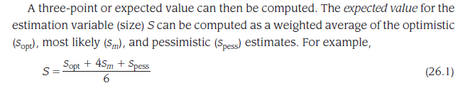
Once the expected value for the estimation variable has been determined, historical LOC or FP productivity data are applied.
Notes:
Optimistic small size, average size and pessimistic large size

Slide 31
An Example of LOC-Based Estimation
As an example of LOC and FP problem-based estimation techniques, I consider a software package to be developed for a computer-aided design application for mechanical components. The software is to execute on an engineering workstation and must interface with various computer graphics peripherals including a mouse, digitizer, high-resolution color display, and laser printer. A preliminary statement of software scope can be developed:

Slide 32
The mechanical CAD software will accept two- and three-dimensional geometric data from an engineer. The engineer will interact and control the CAD system through a user interface that will exhibit characteristics of good human/machine interface design. All geometric data and other supporting information will be maintained in a CAD database. Design analysis modules will be developed to produce the required output, which will be displayed on a variety of graphics devices. The software will be designed to control and interact with peripheral devices that include a mouse, digitizer, laser printer, and plotter.

Slide 33
A range of LOC estimates is developed for each function. For example, the range of LOC estimates for the 3D geometric analysis function is optimistic, 4600 LOC; most likely, 6900 LOC; and pessimistic, 8600 LOC.
Applying Equation 26.1, the expected value for the 3D geometric analysis function is 6800 LOC.

Slide 34
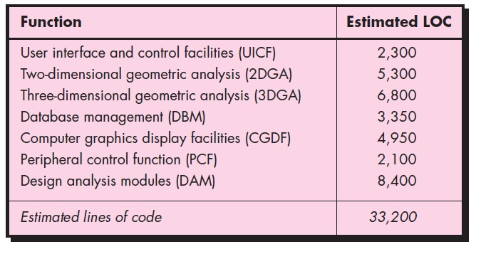
A review of historical data indicates that the organizational average productivity for systems of this type is 620 LOC/pm. Based on a burdened labor rate of $8000 per month, the cost per line of code is approximately $13. Based on the LOC estimate and the historical productivity data, the total estimated project cost is $431,000 (or 432,000 by rounding up) and the estimated effort is 54 person-months
Notes:
8000/620= 13
33200x13= 431,000
33200/620=54

Slide 35
An Example of FP-Based Estimation
Decomposition for FP-based estimation focuses on information domain values rather than software functions. Referring to the table presented in Figure 26.3, you would estimate inputs, outputs, inquiries, files, and external interfaces for the CAD software

Slide 36
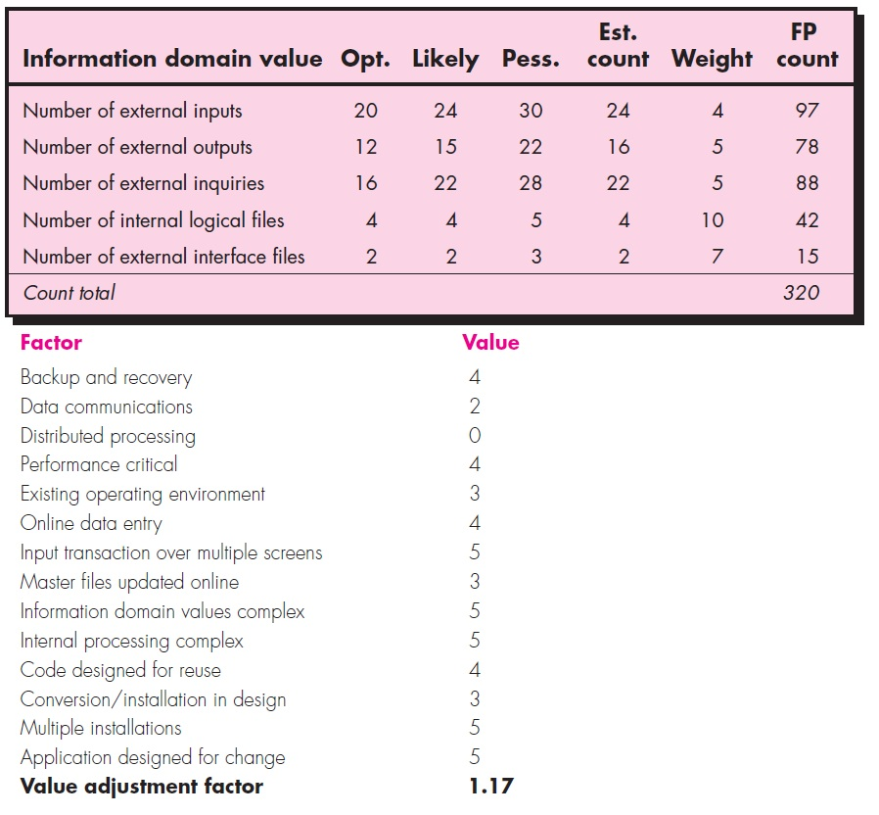
FP= total count x Fi
FP = 375
Notes:
Est. count= S= S(Opt)+4S(likely)+S(Pess)/6
FP count= Est. count x weight
Weight= Average column
Est. count is whole number that’s why FP is 97 instead of 96
Fi=Adjustment Factor= [0.65 +(0.01 x 52)] = 1.17

Slide 37
Practice Question
The organizational average productivity for systems of this type is 6.5 FP/pm. Based on a burdened labor rate of $8000 per month, the cost per FP is approximately $1230.
Based on the FP estimate and the historical productivity data, the total estimated project cost is $461,000 and the estimated effort is 58 person-months.
Notes:
8000/6.5
375x1230=461,000
375/6.5=58

